Slide 1
Evaluating ECAL timing properties using test beam data and Machine Learning
Student: Fakanov Pavel
Supervisor: Ratnikov Fedor

Slide 2
Introduction
We want to apply Machine Learning to process impulse signals coming from ECAL detector
The goal is not to improve particular baseline algorithm with ML
The goal is to use ML to extract the maximum of available in data information and evaluate limitations of the possible physics performance that are driven by behaviours of actual, test beam data
Dominique Breton “A few thoughts about measuring time with the new ECAL of LHCb“
1

Slide 3
A few words about data
Data obtained from the 30 GeV electron beam
Use “output” module of the LHCb electromagnetic calorimeter
Reference time is measured as average of two quick scintillator counters
5GHz sampling rate
1

Slide 4
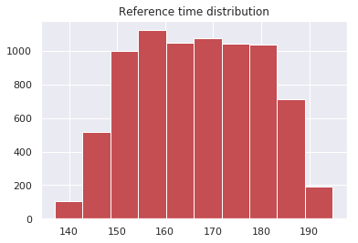
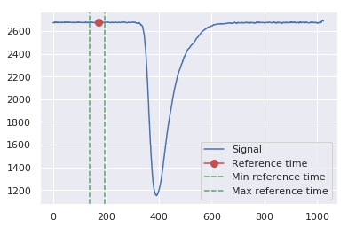
Problem 1. Predict reference time for a signal
1

Slide 5
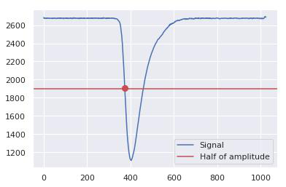
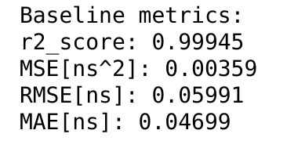
Baseline method description
As we can see even baseline solution gives us excellent metrics
1
Notes:
1

Slide 6
Linear regression out of the box
Model\Metric | R2 score | MSE [ns^2] | RMSE [ns] | MAE [ns]
Linear regression | 0.99904 | 0.00628 | 0.07921 | 0.06126
Baseline | 0.99945 | 0.00359 | 0.05991 | 0.04699
Let’s try to beat baseline score by adding polynomial features to our model, but at first let’s try to reduce the dimension of our samples
1

Slide 7
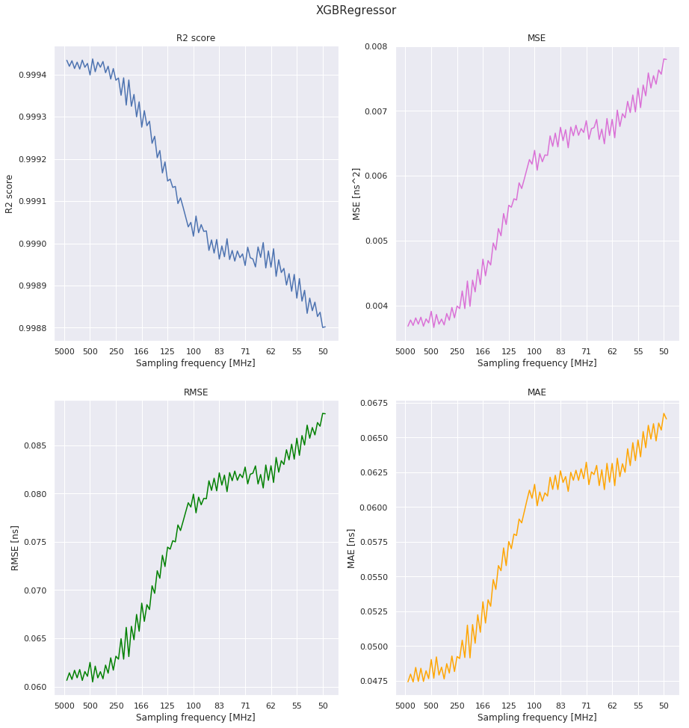
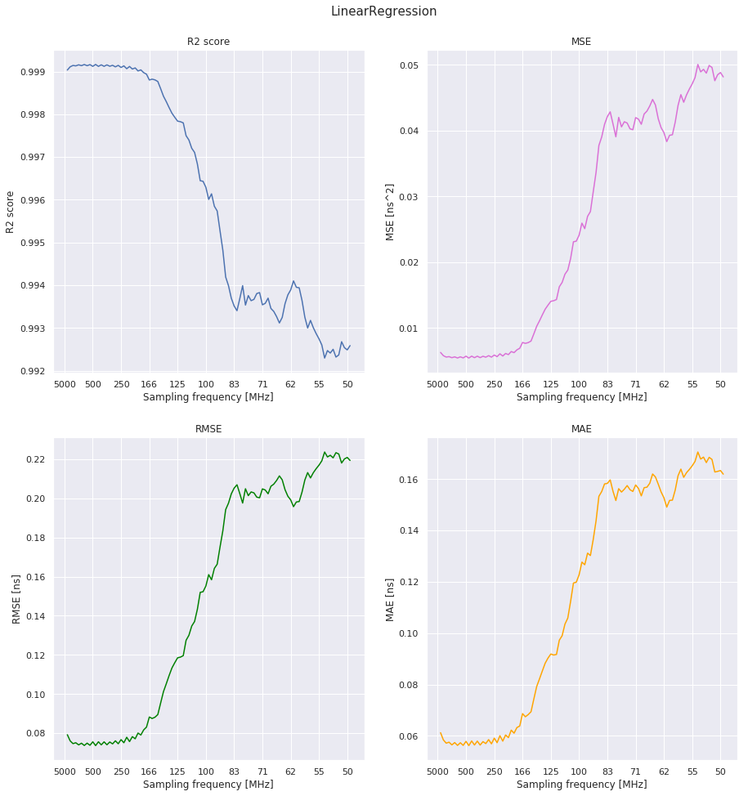
Scores dependency on sampling frequency
We can reduce the sampling frequency by 20 times!!!
1

Slide 8
Linear regression with polynomial features
Model\Metric | R2 score | MSE [ns^2] | RMSE [ns] | MAE [ns]
Linear regression + polynomial features + dimensionality reduction | 0.99956 | 0.00285 | 0.05337 | 0.04194
Baseline | 0.99945 | 0.00359 | 0.05991 | 0.04699
1

Slide 9
Data preprocessing does matter
Model\Metric | R2 score | MSE [ns^2] | RMSE [ns] | MAE [ns]
Linear regression + preprocessing + dimensionality reduction | 0.99965 | 0.00226 | 0.04749 | 0.03728
Linear regression + preprocessing | 0.99963 | 0.00242 | 0.04921 | 0.03892
Baseline | 0.99945 | 0.00359 | 0.05991 | 0.04699
1

Slide 10
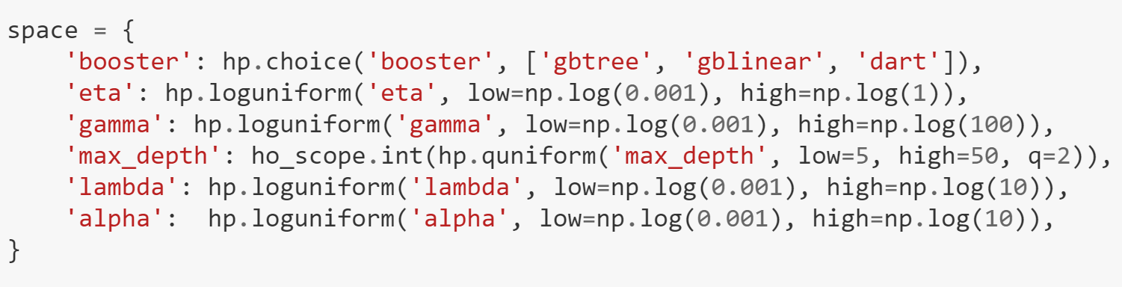
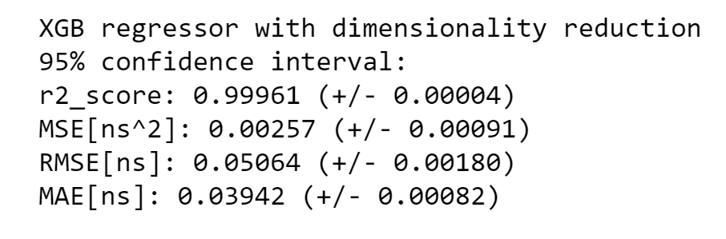
Model tuning
1

Slide 11
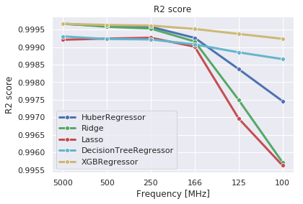
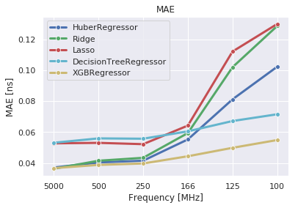
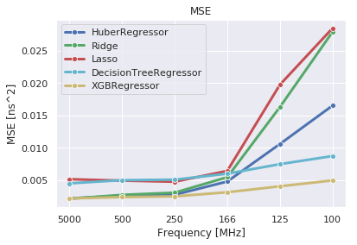
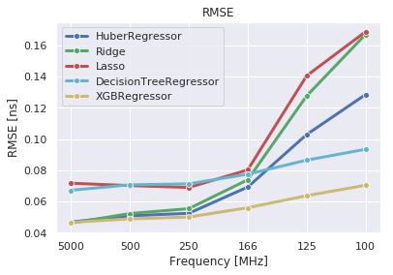
Models comparison
1
It illustrates that we can recover reference time extremely accurate even with sampling frequency = 250 MHz

Slide 12
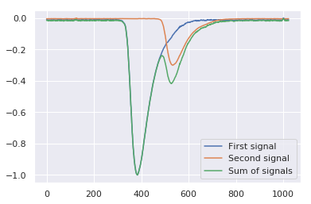
What if there are two signals?
1

Slide 13
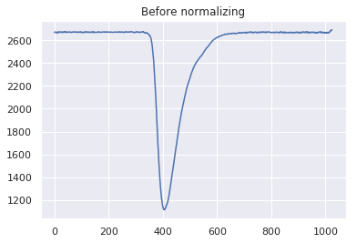
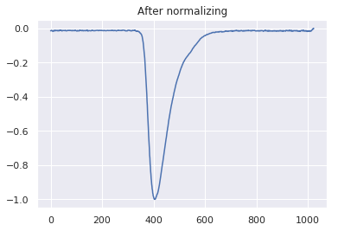
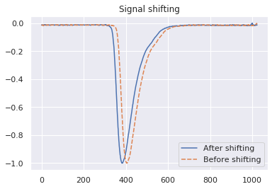
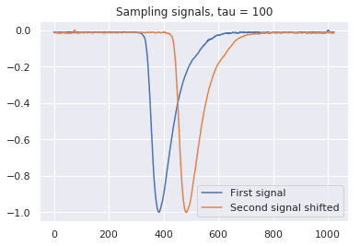
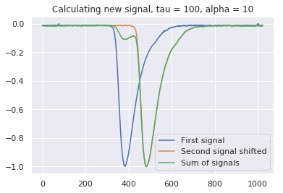
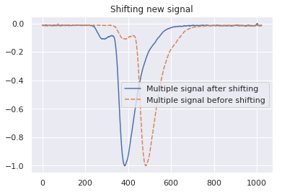
A few words about data preparation
1

Slide 14
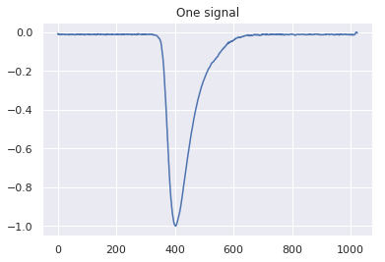
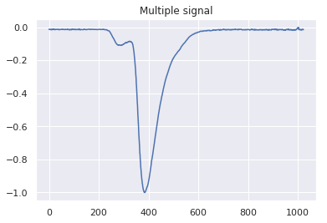
Problem 2.
Identify the presence of two signals
1
Notes:
1

Slide 15
Problem 2. Pipeline
Data preparation
Defining sklearn models
Ensemble of models
(weighted voting)
Hyperopt
1

Slide 16
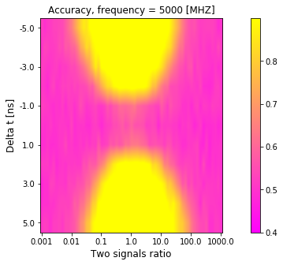
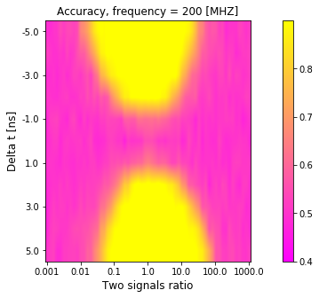
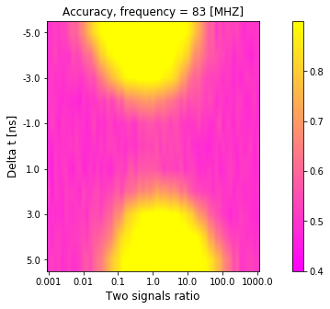
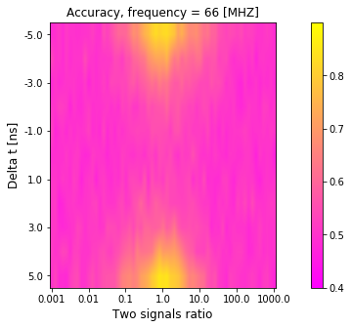
Problem 2. Results
1

Slide 17
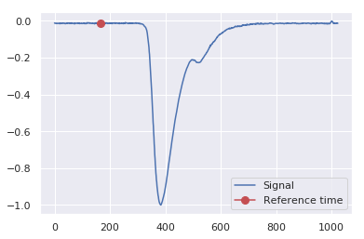
Problem 3.
Predict the reference time of a multiple signal
We will predict the reference time of a more significant signal
1

Slide 18
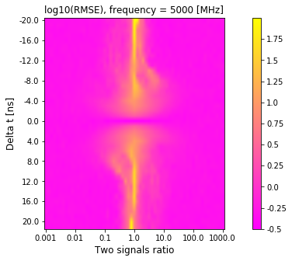
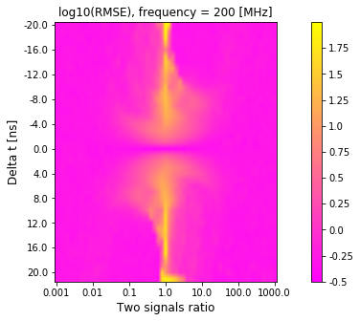
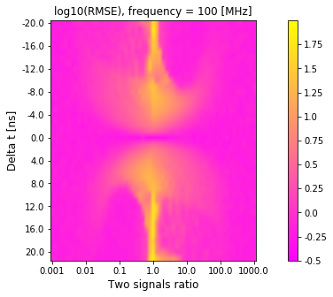
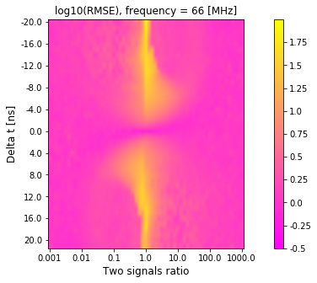
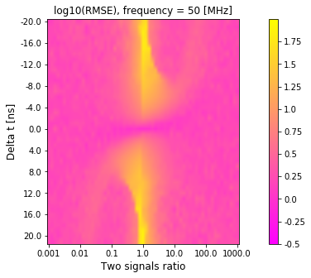
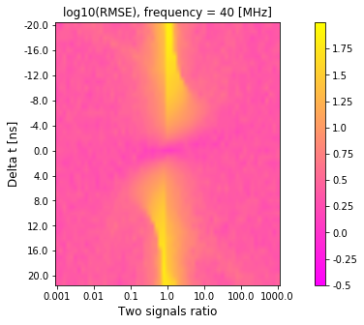
Problem 3. Results
1

Slide 19
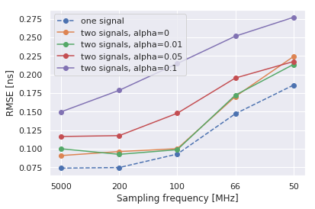
Comparing the scores of a model for one signal and a model for two signals
1

Slide 20
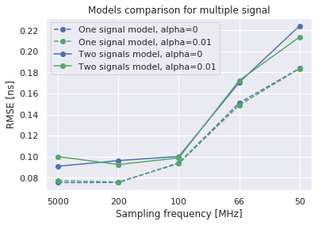
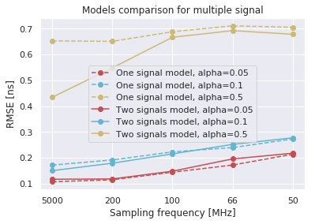
What if we use a model for one signal to predict a multiple signal?
1

Slide 21
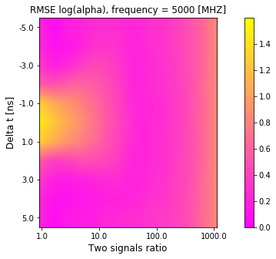
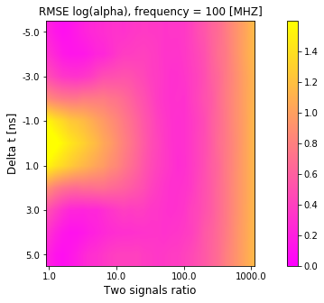
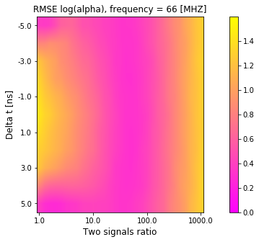
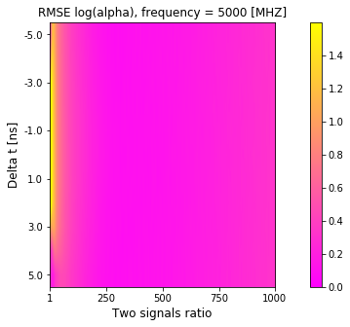
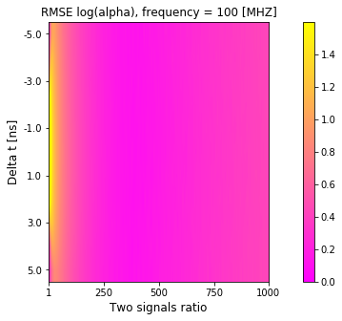
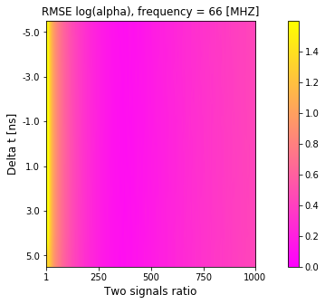
Problem 4. Let’s try to extract alpha from a multiple signal
Log train distribution
Uniform train distribution
1

Slide 22
Conclusions
Using non-parametric ML approaches allows comprehensive evaluation of different properties from different perspectives
Using signals obtained in test beam measurements we estimated
Effect of signal sampling rate on the timing resolution
Efficiency to identify presence of another particle in the signal
Disturbing of time measurements due to another particle contribution in the signal
Obtained results may be plugged into the physics simulation to evaluate effects of higher occupancies on ECAL reconstruction
1

Slide 23
Any questions?
Mail: pavel.fakanov@gmail.com
Github: https://github.com/whiteRa2bit/cern_summer_project

